Slide 1
WELCOME

Slide 2
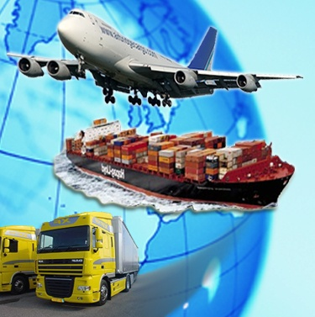
Presentation On
IMPORT
EXPORT

Slide 3
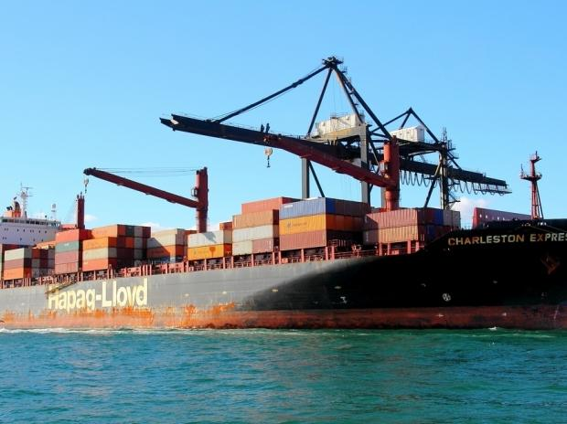
Definition
Import:-
The term import is derived from the conceptual meaning as to bring in the goods and services into the port of a country.
The buyer of such goods and services is referred to an "importer"

Slide 4
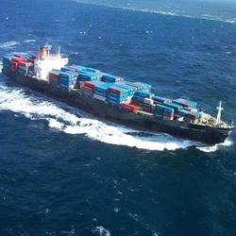
Definition
Export:-
This term export is derived from the conceptual meaning as to ship the goods and services out of the port of a country.
The seller of such goods and services is referred to as an "exporter"

Slide 5
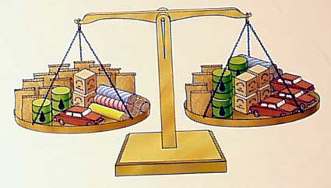
Balance Of Trade
Balance of trade represents a difference in value for import and export for a country.
A trade deficit occurs when imports are large relative to exports.
Imports are impacted principally by a country's income and its productive resources.

Slide 6
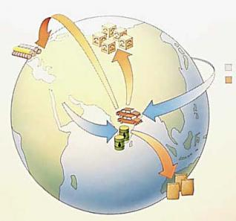
Types of Import
There are two basic types of import:
Industrial and consumer goods
Intermediate goods and services

Slide 7
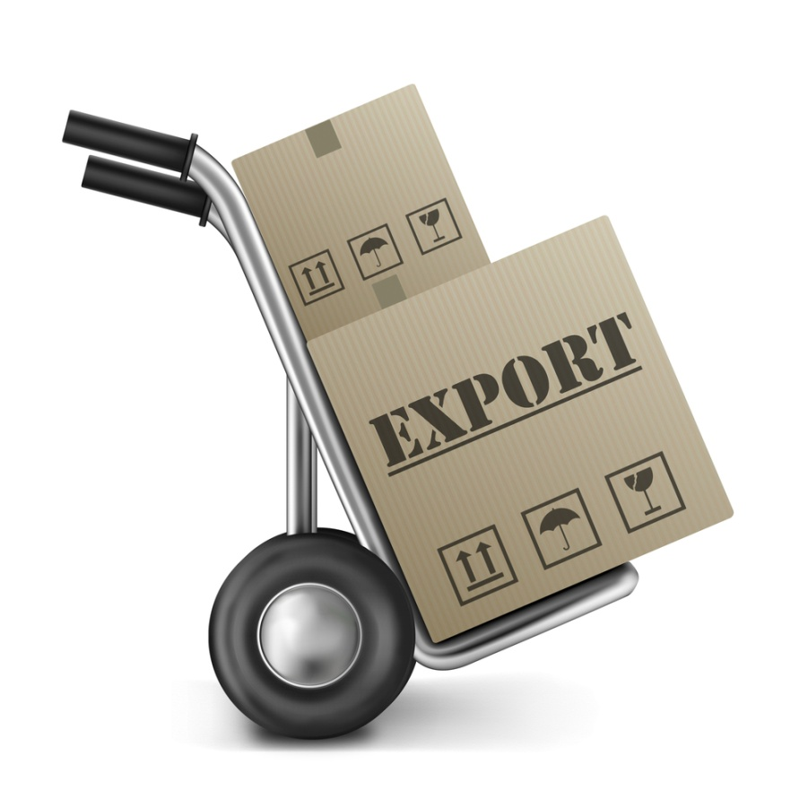
Types of Export
Physical Export : If goods physically go out of the country.
Deemed Export : If goods and services are supplied to another entity.

Slide 8
EXPORT IMPORT PROCESS
REGISTER AS AN IMPORTER OR EXPORTER
NEGOTIATE TERMS OF SALE
UNDERSTAND EXPORT FORMALITIES AND RESPONSIBILITY TOWARDS SALE PROCEEDS
UNDERSTAND DOCUMENTATION AND INCOTERMS
FOR EXPORT,COMPLETE CUSTOMS FORMALITIES AND OBTAIN DOCUMENTS
SUBMIT TO THE BANK FOR ONWARD TRANSMISSION TO BUYER
RECEIVE SALE PROCEEDS

Slide 9
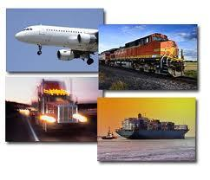
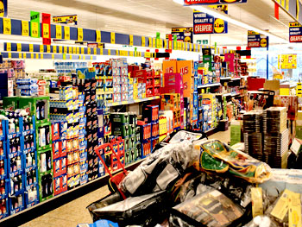
Advantages of Import
Reduce dependence on existing markets
Exploit international trade technology
Extend sales potential of existing products
Maintain cost competitiveness in your domestic market

Slide 10
Disadvantages Of Import
Importation of items from other countries can increase the risk of getting them which is no more common in the warm weather.
it leads to excessive competition
It also increases risks of other diseases from which the country is exporting the goods.

Slide 11
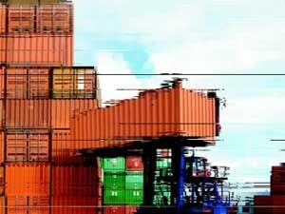
Advantages Of Export
Exporting is one way of increasing your sales potential
Increasing sale& profits
Reducing risk and balancing growth
Sell Excess Production Capacity.
Gain New Knowledge and Experience

Slide 12
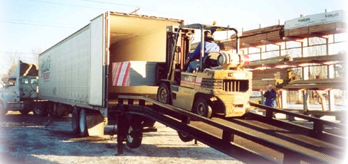
Disadvantages Of Export
Extra Costs
Financial Risk
Export Licenses and Documentation
Market Information

Slide 13
MODES OF PAYMENT
In order to complete the export process,the payment of the exported goods has to be received by the exporters.An exporter can receive the export proceeds as
ADVANCE PAYMENT
PAYMENT AGAINST DOCUMENTARY BILLS
PAYMENT AGAINST DOCUMENTARY BILLS UNDER LETTER OF CREDIT

Slide 14
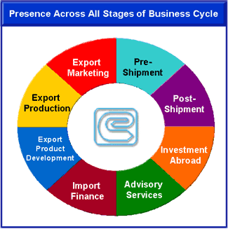
EXIM Bank

Slide 15


EXIM Bank
Export-Import Bank of India is the premier export finance institution of the country, established in 1982 under the Export-Import Bank of India Act 1981
Government of India launched the institution with a mandate, not just to enhance exports from India, but to integrate the country’s foreign trade and investment with the overall economic growth. like other Export Credit Agencies in the world, Exim Bank of India has, over the period, evolved into an institution that plays a major role in partnering Indian industries, particularly the Small and Medium Enterprises, in their globalisation efforts, through a wide range of products and services offered at all stages of the business cycle, starting from import of technology and export product development to export production, export marketing, pre-shipment and post-shipment and overseas investment.

Slide 16
EXIM Bank
Exim Bank of India has been the prime mover in encouraging project exports from India.
The Bank extends lines of credit to overseas financial institutions, foreign governments and their agencies, enabling them to finance imports of goods and services from India on deferred credit terms.
The Bank provides financial assistance by way of term loans in Indian rupees/foreign currencies for setting up new production facility, expansion/modernization/upgradation of existing facilities and for acquisition of production equipment/technology. Such facilities Such facilities particularly help export oriented Small and Medium Enterprises for creation of export capabilities and enhancement of international competitiveness.
The Bank has launched the Rural Initiatives Programme with the objective of linking Indian rural industry to the global market. The programme is intended to benefit rural poor through creation of export capability in rural enterprises.

Slide 17

EXIM Bank
Exim Bank supplements its financing programmes with a wide range of value-added information, advisory and support services, which enable exporters to evaluate international risks, exploit export opportunities and improve competitiveness, thereby helping them in their globalisation efforts.

Slide 18
Support Institutions to Facilitate Exports
Some of these institutions are:
Export Credit Guarantee Corporation (ECGC)
Exim Bank of India
India Trade Promotion Organisation (ITPO)
Export Inspection council (EIC)
Indian Institute of Packaging (IIP) contd

Slide 19
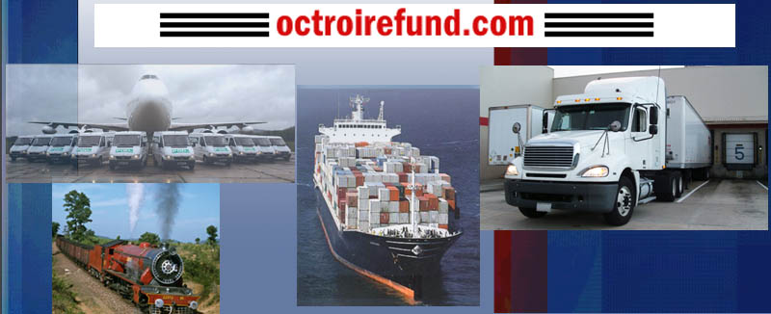
OCTROI
.
The state government levies the octroi charges when the product enters the state. This charge is applicable to certain states and fluctuates as per the Government regulations and we are unable to confirm the amount.

Slide 20

ECGC
The Export Credit Guarantee Corporation of India Limited(ECGC) is a company wholly owned by the Government of India based in Mumbai, Maharashtra. It provides export credit insurance support to Indian exporters and is controlled by the Ministry of Commerce. Government of India had initially set up Export Risks Insurance Corporation (ERIC) in July 1957.

Slide 21

ECGC LOGO

Slide 22
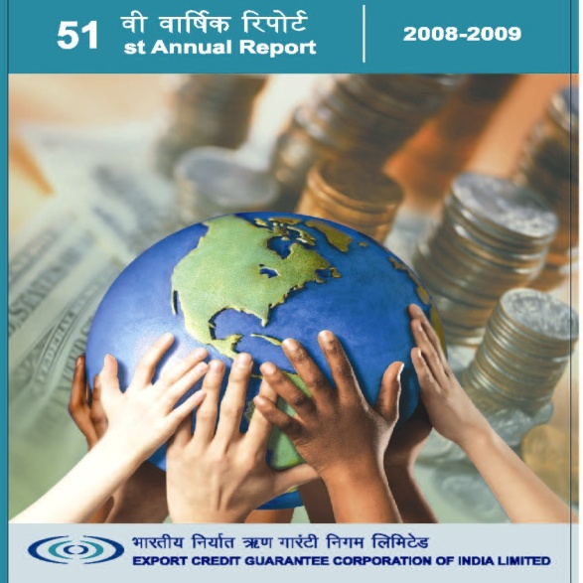
ECGC
What does ECGC do?
Provides a range of credit risk insurance covers to exporters against loss in export of goods and services.
Offers guarantees to banks and financial institutions to enable exporters to obtain better facilities from them.
Provides Overseas Investment Insurance to Indian companies investing in joint ventures abroad in the form of equity or loan.
Information on different countries with its own credit rating
Assists the exporters in recovering bad debts

Slide 23
Exports & Import – General Provisions in Foreign Trade Policy
The interpretation of Policy: DGFT is the final authority. Any exemption from policy or procedure also to be referred to DGFT
Freedom to export & import except to the extent of provisions in the Foreign Trade Policy or any other law in force
Every exporter/importer must comply with the provisions of the Foreign Trade (Development & Regulation) Act 1992
No agency shall withhold consignments allowed for exports. Free movement of export goods is allowed. Authority can take undertaking from exporter in case of any doubt

Slide 24
Specific Provisions
Free exports
All exports in freely convertible currency except in specific situations
Realization of export proceeds within a specified time
Deemed exports

Slide 25
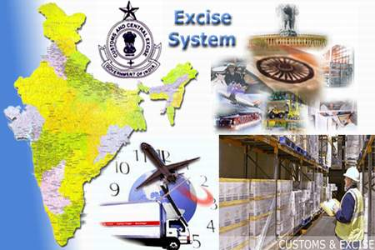
Excise Duty
An excise or excise tax (sometimes called a duty of excise special tax) is an inland tax on the sale, or production for sale, of specific goods or a tax on a good produced for sale, or sold, within a country or licenses for specific activities. Excises are distinguished from customs duties, which are taxes on importation

Slide 26

Custom Duty
.
Customs duty is a kind of indirect tax which is realized on goods of international trade. In economic sense, it is also a kind of consumption tax. Duties levied by the government in relation to imported items is referred to as import duty. In the same vein, duties realized on export consignments is called export duty. Tariff, which is actually a list of commodities along with the leviable rate (amount) of Customs duty, is popularly understood as Customs duty.
Custom Officer U.K

Slide 27
INCOTERMS
The Incoterms rules or International Commercial terms are a series of pre-defined commercial terms published by the International Chamber of Commerce (ICC) widely used in international commercial transactions.It defines the trade contract ,responsibilities and liabilities between the buyer and the seller
These terms make international trade easier and help traders in different countries to understand the responsibilities and rights of the buyers and sellers.
SOME OF THE TERMS ARE-
EXW – Ex Works (named place of delivery)
FCA – Free Carrier (named place of delivery)
CPT - Carriage Paid To (named place of destination)
CIP – Carriage and Insurance Paid to (named place of destination)
DAT – Delivered at Terminal (named terminal at port or place of destination)
DAP – Delivered at Place (named place of destination)
DDP – Delivered Duty Paid (named place of destination)

Slide 28
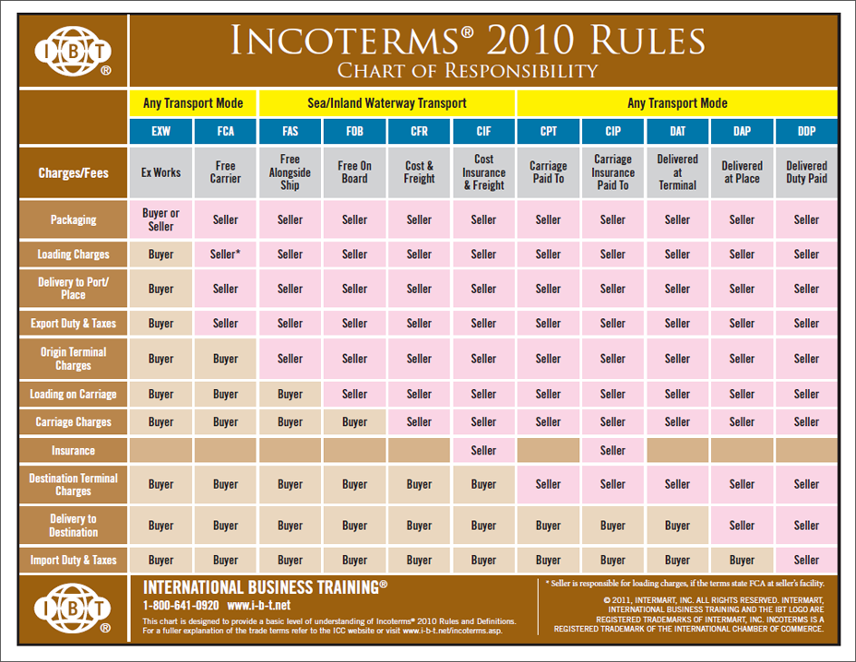
INCOTERMS

Slide 29

Submitted by:
Rati Kaul

